Slide 1
CORPORATE PRESENTATION I 2024
HAYLEYS PLC I Sri Lanka’s Corporate Inspiration

Slide 2
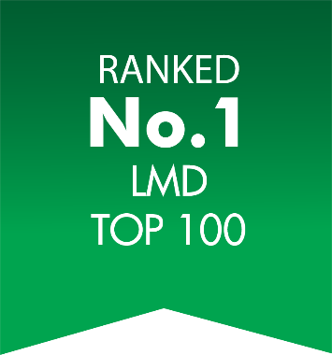
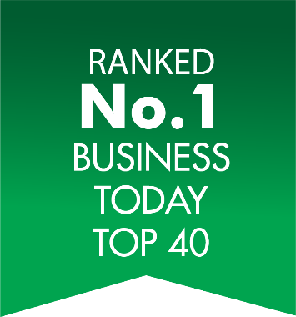
SRI LANKA’S CORPORATE
INSPIRATION
Ranked the No.1 corporate in Sri Lanka
Sri Lanka’s largest and most diversified conglomerate
Touching the lives of millions through 16 business sectors
146 years in Business
Billion dollar export company, contributing 5% of Sri Lanka’s export income
Business strongholds across 5 continents, in over 80 countries globally
Over 36,000 employees building leadership businesses
Our nation’s 5-time Best Corporate Citizen, channeling value to over 2 million lives everyday
2023/2024
2020/21
2021/22

Slide 3
DELIVERING PROFITABLE GROWTH FOR 2023/24
USD 1.38 Bn
Annual Revenue
USD 171 Mn
EBITDA
USD 80 Mn
Profit Before Tax
USD 47 Mn
Profit After Tax
‘AAA’ RATED BY FITCH RATINGS
Read our latest
Integrated Annual Report
Assigned the highest possible national long term corporate credit rating

Slide 4
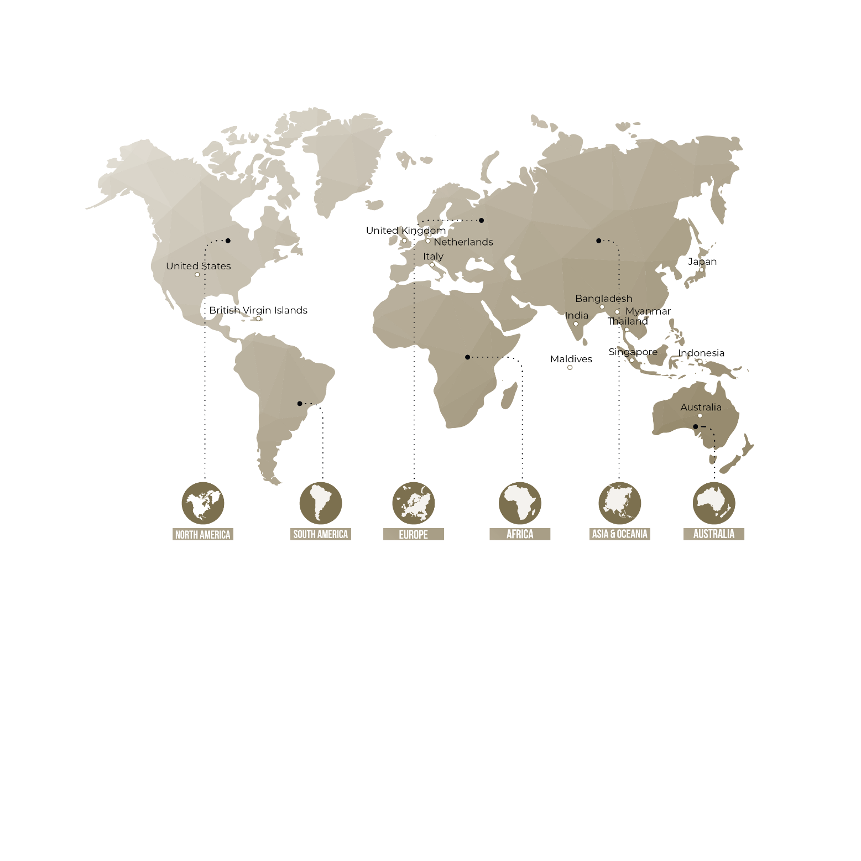
TAKING ON THE WORLD…
Supplies 5% of the global demand for household and industrial gloves.
Leader in the global coconut shell-based activated carbon market.
Sri Lanka’s largest exporter of processed fruits and vegetables.
Leader in Sri Lanka’s Transportation and Logistics Sector.
Pioneer and largest textile manufacturer and exporter in Sri Lanka.
Sri Lanka’s largest exporter of aluminium extrusion products.
A global reach in over
80 countries worldwide
Leading Rooftop Solar Contractor, with over 200MW installed islandwide.
One of the world’s most awarded, sustainable plantations, producing 4.6%
and 4.1% of Sri Lanka’s tea and rubber
Sri Lanka’s largest manufacturer
and supplier of consumer durables, with 400+ outlets island-wide.

Slide 5
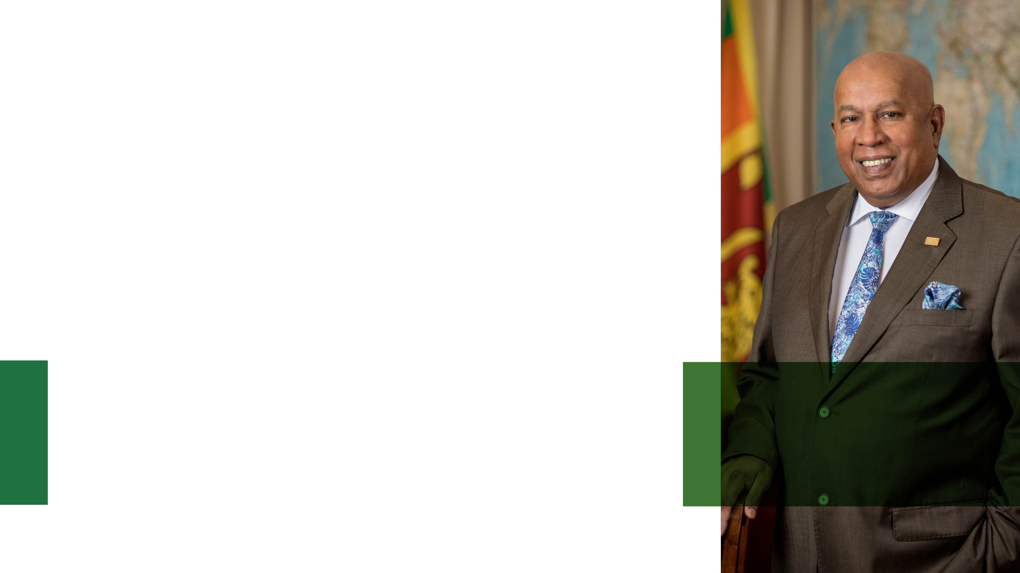
OUR LEADERSHIP
Chairman & Chief Executive - Mr. Mohan Pandithage
Serves as Honorary Consul of the United Mexican States (Mexico) to Sri Lanka.
Obtained Leadership Excellence Recognition by the Institute of Chartered Accountants of Sri Lanka.
Honoured with the first-ever “Sri Lanka Pinnacle Lifetime Award”
Chartered Institute of Logistics and Transport (CLIT)
Honoured with the “Lifetime Achievement Award” Sea trade–Sri Lanka Ports,
Trade and Logistics (SLPTL)
Inducted as a “Legend of Logistics” Sri Lanka Logistics and Freight Forwarding Association (SLFFA)
The Hayleys Group Management Committee is the apex management committee of the Group, chaired by the Chairman & Chief Executive and comprises some of the most esteemed profiles in the industry. These include the Executive Directors of the Group, the Chief Financial Officer, the Head of Human Resources Officer and Sector Heads.
Mr. Mohan Pandithage
Chairman and Chief Executive

Slide 6
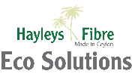
Introduction of
India
Sri Lanka
Hayleys Eco Solutions is a sector of Hayleys PLC, specializing in coco natural fiber products. We manufacture a wide range of coco-based products such as coco substrate, horticulture, brushes, brooms, mats, erosion control products, and industrial fiber solutions. Committed to sustainability, Hayleys Fibre utilizes eco-friendly processes to produce high-quality, durable goods for both local and international markets.
1.2 Million
Grow bag Capacity per month
1 Million
Coco Block Capacity per month
7,500+ MT
Stock holding capacity
6
Coco Substrate Factories (With India)
145+ Years
Experience
3,000+
Employees
250+
FEU Containers per month
7
Other Coco product Factories

Slide 7
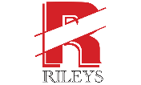
ECO FIBRES
BRUSHWARE
FLOOR COVERONG
Sub Sectors
Eco Solutions represents the Coir fibre products sector of Hayleys which in turn is denoted by three sub-sectors. Hayleys Fibre is responsible for manufacturing principally industrial products and mattresses.
HAYLEYS FIBRE I BRUSHWARE I FLOOR COVERINGS

Slide 8
Coco Substrate Product Range
Grow Bags
Grow Blocks &Bricks
Open Top Bags
Available in different mixes of coco fibre pith and coco husk chips

Slide 9
Grow Bag
Mainly used in commercial greenhouses and nurseries.
Tomatoes, strawberries, bell peppers, and cucumbers are commonly grown crops.
The combination of coco fibre pith and coco husk chips varies based on the crop's aeration and water retention needs.
Packing Information
Dimensions: Up to 120 cm x Up to 25 cm x Up to 25 cm (Customized according to different plant varieties and customer requirement)
Bag treated with UV protection to last the growing cycle
6,000 to 15,000 Grow bags fit in a 40ft container (Based on size)
We developed customized blends based on our research and industry expertise.
Tomato
Strawberry
Bell Pepper
Cucumber

Slide 10
Coco Blocks & Bricks
Mainly used in commercial nurseries and potting soil mixing companies
Ideal for Vegetables, flower cultivation, farms and potting mixtures
Available in 5kg & 650 g brick
The combination of coco fibre pith and coco husk chips varies based on customer requirement
Packing Information for 5KG block
Dimensions: 30 cm x 30 cm x 14 cm
Expansion: 65-70 L per block vary with the coco fibre and husk chip ratio
Per 40 ft container - 4,800 Units
Packing Information for 650g brick
Dimensions: 20 cm x 10 cm x 5 cm
Expansion: 6-7 L per block vary with the coco fibre and husk chip ratio
Per 40 ft container - 38,880 Units

Slide 11
Open Top Bag
Mainly used in commercial nurseries and greenhouses
Blueberry and medicinal cannabis cultivation is increasingly popular using open-top bags.
The combination of coco fibre pith and coco husk chips varies based on customer requirement
We developed customized blends based on our research and industry expertise.
Packing Information
Dimensions: Up to 30 cm x Up to 30 cm x Up to 40 cm
Per 40ft container : Up to 8,000 Units (Based on dimensions)
UV treated bag to last the growing cycle
Blueberry
Medicinal Cannabis

Slide 12
Our Global Reach
Key Markets
United States of America
UK
Germany
Austria
Italy
Netherlands
Azerbaijan
Morocco
Uzbekistan
Turkey
Mexico
Peru
#01 Grow Bag Exporter
75+ Countries
500+ Customers
Primary grow bag Supplier for Europe’s #01 cherry Tomato supplier
Covering 5 Continents

Slide 13
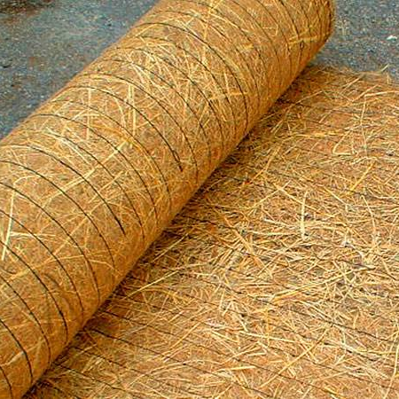
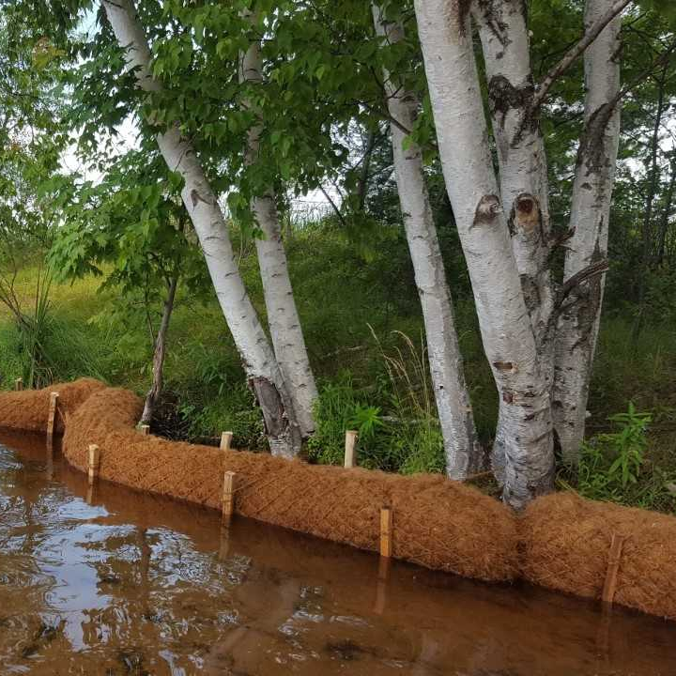
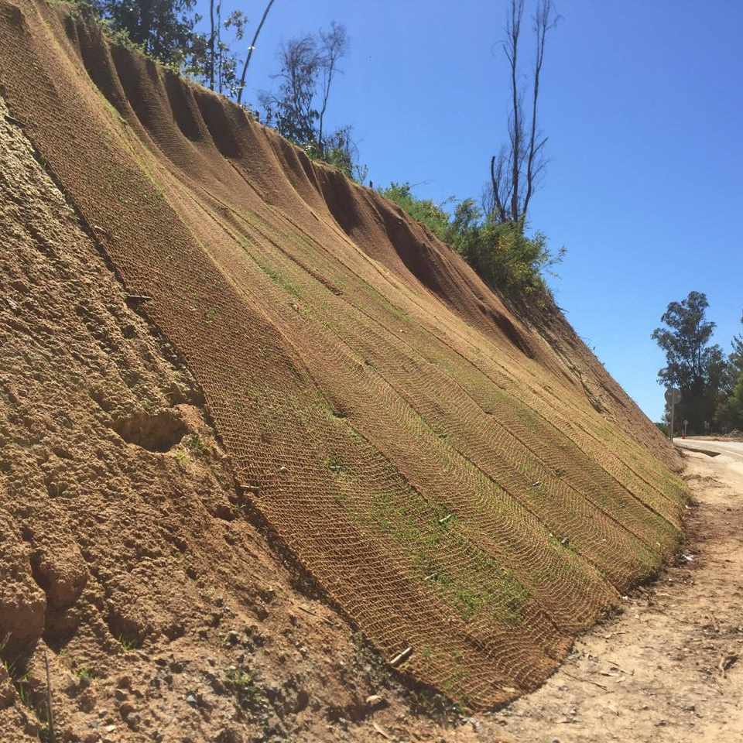
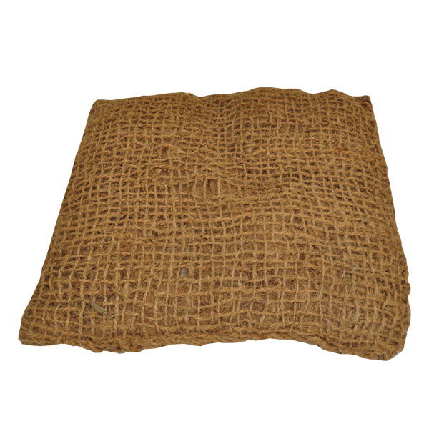
Bio Engineering
ECO-FRIENDLY SOLUTIONS FOR EROSION CONTROL AND NATURAL STABILISATION
Bio-Engineering provides natural shoreline stabilisation techniques that can effectively reduce erosion of exposed soil, sand and other sediments from wind and waves. It also helps to redress overland runoff, while providing storm damage protection to landward areas. The technology aids stabilisation of roads, slopes, riverbanks and highways prone to damages of erosion through natural or other causes.
The Bio-Engineering sector of Hayleys Fibre specialises in providing a range of long-term solutions, through the use of natural coconut fibre products. Coconut fibre has high lignin and low cellulose content, adding to its durability and resilience.
EROSION CONTROL BLANKETS
COIR LOGS (COIR ROLLS)
COIR TWINE GEOTEXTILE
(COIR TWINE MATTING)
COIR PILLOWS

Slide 14
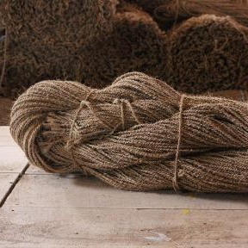
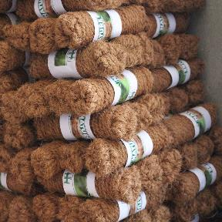
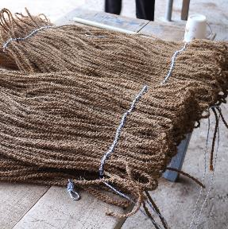
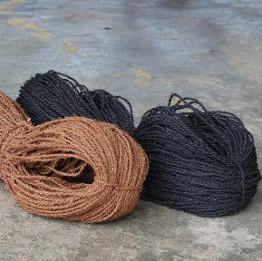
Coir Twine & Yarn
COCONUT COIR TWINE & YARN
The Coir Twine & Yarn sector of Hayleys Fibre specialises in manufacturing twine and yarn for a variety of industries.
Made from the bristle fibres of the husk of the coconut, coir twine is eco-friendly, biodegradable, and has many unique uses due to its natural characteristics. Its strength, texture and versatility enable a variety of industrial usage – stringing hops and other vines, horticulture, gardening, matting and carpet, and a base for oyster cultivation. Available in two-ply and three-ply, the coconut coir twine has a breaking strength of up to 100 lbs, depending on its thickness, which ranges from 3.5 mm to 12 mm, and can be customised according to customer requirements.
HOP TWINE
GARDEN TWINE
AQUA TWINE
MATTING & CARPET TWINE

Slide 15
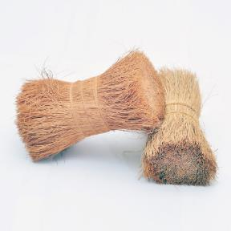
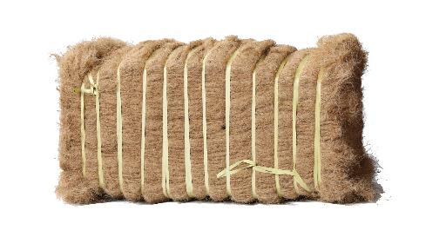
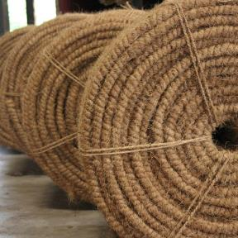
Industrial Fibre
INDUSTRIAL FIBRE
Extracted from the husk of the coconut, coco fibre is used in many industries due to its 100% natural and eco-friendly features. The fibre can be further developed into Bristle, Twisted or Bale Fibre, and used in a variety of different forms for home, agricultural and industrial purposes.
BRISTLE FIBRE
TWISTED FIBRE (CURL COIR)
FIBRE IN BALES

Slide 16
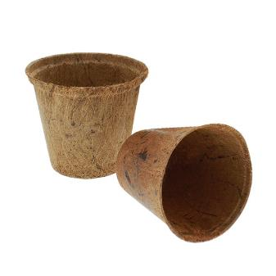
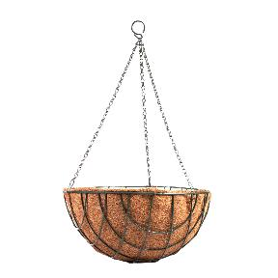
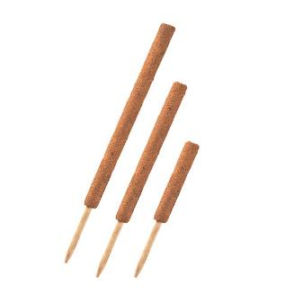
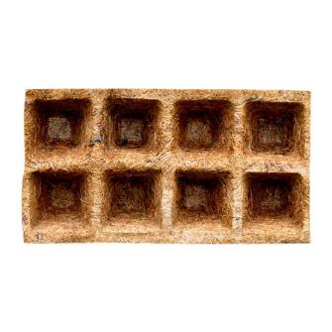
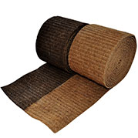
Horticulture
GROWER SOLUTIONS FOR HEALTHY PLANT LIFE
The Horticulture sector of Hayleys Fibre specialises in manufacturing products for garden cultivation and management, to promote and enhance healthy plant life. These are categorised into Coir Moulded products, Needled Coir Liners, Rubberised Coir Liners, Coco Poles and Moisture Retainers, among others. The 100% natural and biodegradable range can be customised based on dimension, colour, packaging and branding preferences. We export to the USA, Europe, Australia, Asia and South Africa. Industry guidelines and standards of safety are followed in every stage of production, with specific certification in Business Social Compliance Initiative (BSCI) and ISO 9000: 2018.
RUBBERISED COIR MOULDED PRODUCTS
Coir moulded products are manufactured using rubberised coir sheets bound with natural latex and moulded into different shapes. They assist in better plant growth and are used to ensure efficient absorption of water and nutrition, including the provision for better plant root aeration. Categories include Coir Basket Liners, Coco Poles, Coir Pots and Coir Seedling Trays.
SEEDLING TRAYS
COCO POTS
COCO POLES
BASKET LINERS
BARK GUARDS

Slide 17
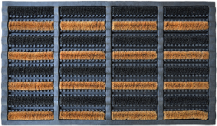
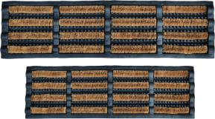
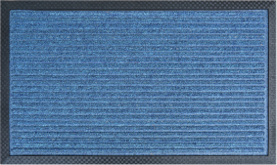
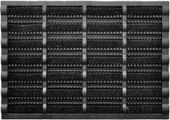
Combined Mats
The coir and rubber combined door mats acts as an effective dirt remover to keep carpets and floors free from moisture and dust. All of these items includes a sturdy rubber backing to help keep them in one place, while the coir pile makes them fit for the job and long lasting.
DFG 2016 - 015
75CM X 45CM
DFG 19 – 02 25CM X 60CM
&
DFG 19 – 03 30CM X 75CM
BLUE LINES DFG 113 STRP
DFG 181 BRP
60CM X 40CM
CARE INSTRUCTIONS
Pile contains 100% natural coir
Best for Outdoor use
Coir is a natural product, therefore some shedding may initially occur
Exert caution when using on floors that could cause the mat to slip

Slide 18
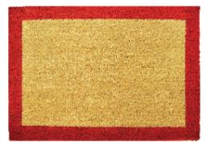
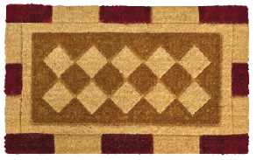
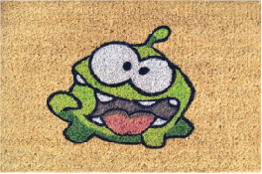
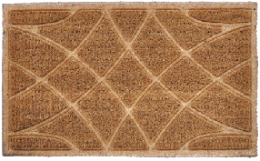
Woven Coir Mats
Our collection of machine woven coir mats provides an extremely effective barrier against dust, mud and dirt from entering your home. These coir mats can last up to a period of 5 years if you take good care of the mat you purchase and is an absolute value for money. The latex edged mats provides good grip. While our non-latex edged mat suites the traditional BR1 type mat, Difference being ours is machine woven which makes the product a high quality mat with longer life span.
HAY - 001
REGAL
PL 2017 - 02
KOKO PRESS LINES
CARE INSTRUCTIONS
100% Natural coir
Durable PVC backing
REACH compliant
Suitable for outdoor use

Slide 19
Finished Products
BA170APB
BR825CPN
BR553ACBE
BA141ACN
BA170APB
BA175FCD
BR913APGL
BR913ACNL

Slide 20
Our Purpose, Vision & Mission
Purpose
“Inspire Innovative and Inclusive Eco-Friendly living”
Vision
To be the leading provider of innovative, sustainable and environmental friendly products and solutions.
Mission
To be the globally preferred choice by delivering value to all stakeholders through a range of sustainable and environmental friendly products and solutions.

Slide 21
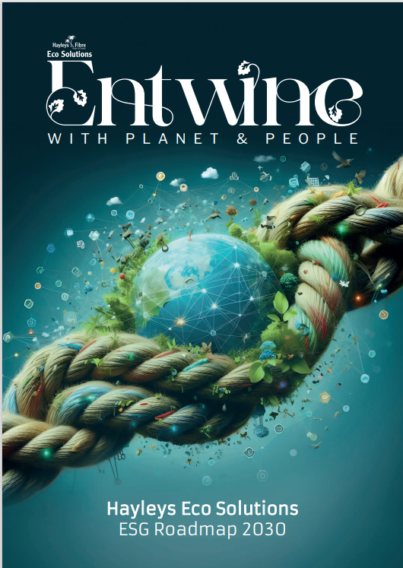
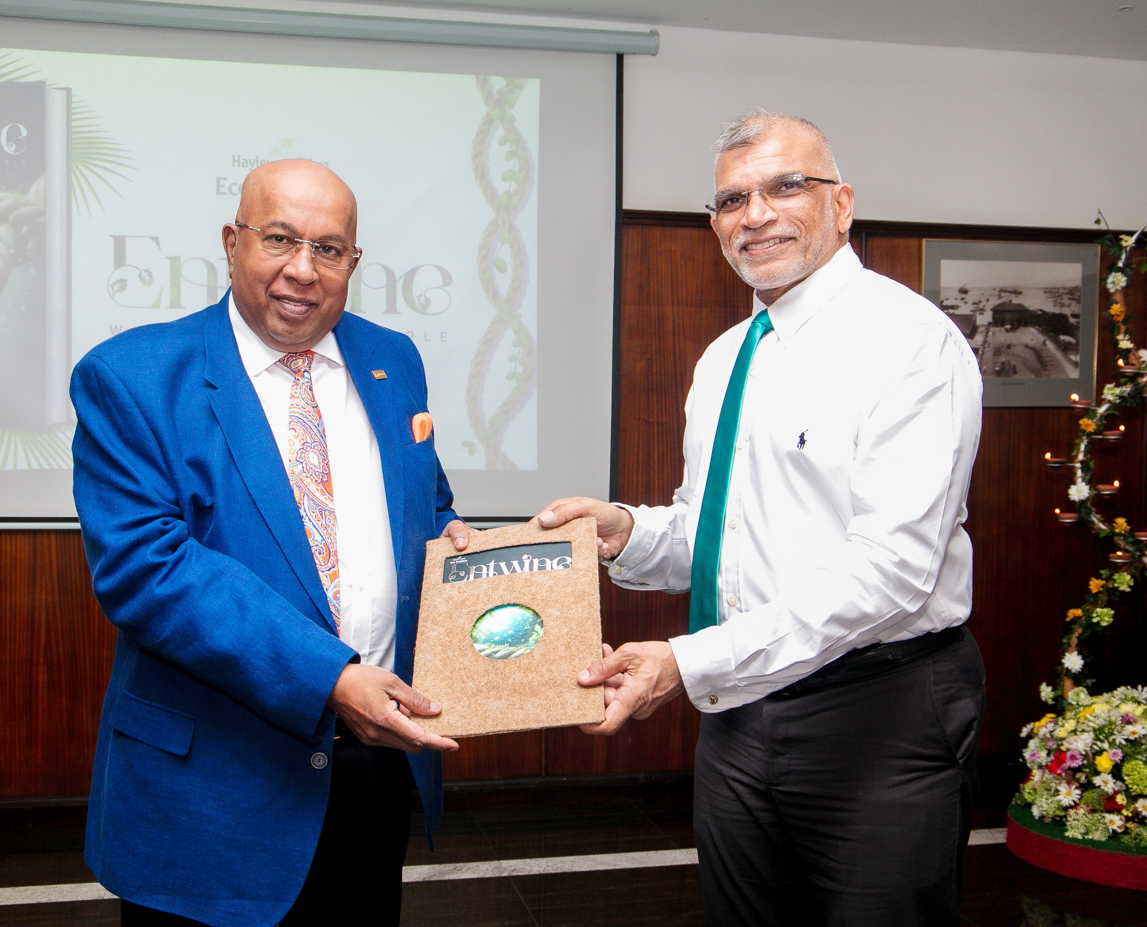
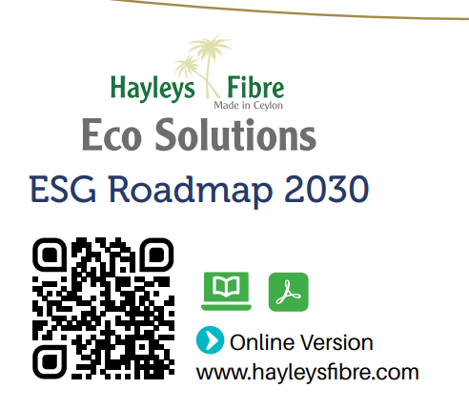
Entwine- Our Roadmap for ESG

Slide 22
Building a Better Tomorrow....
Supporting school children in rural areas

Slide 23
Our People
Our Strength

Slide 24
Employee Wellbeing...
`

Slide 25
Together We Rise....
Community development projects

Slide 26
Certifications & Awards
Business Social Compliance Initiative
Supplier Ethical Data Exchange Certified
Forest Stewardship Council Certified
Global Organic Latex Standard
Organic Content Standard
ISO 9001:2015
Winner of National Chamber of Exporter’s, awards in multiple times.
SA 8000
ISO 14000:2004
SA 9001

Slide 27
Thank
You !

